Slide 1
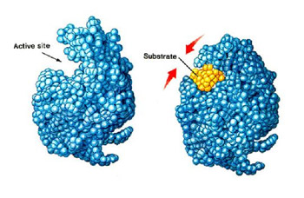
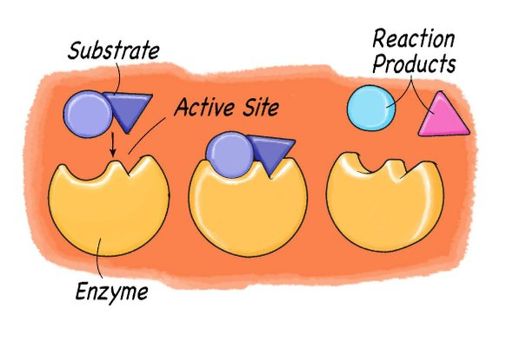
Enzyme Activity
Experiment 4

Slide 2
What is an enzyme?
A biological catalyst that speed up the rate of chemical reactions in living organisms by lowering the activation energy without being changed or used up.
Most of them are proteins with 3D (Globular) structure.
Enzymes are specific and speed only one type of reaction.
Enzymes are often named by adding “-ase”
Example: Dehydrogenase: An enzyme that remove hydrogen.

Slide 3
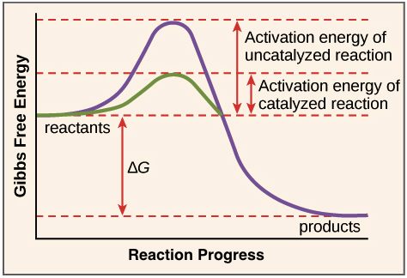
How do enzymes catalyze reactions?
By lowering the activation energy* required to:
Break bonds in reactants
Form new bonds in products
* the least possible amount of energy required to start a reaction

Slide 4
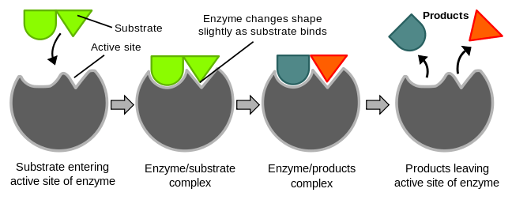
How do enzymes work?
Enzyme binds to a substrate (reactant) at its active site to form an enzyme-substrate complex, converting reactants to products without being changed.
Enzymes take part in the reaction, but not changed during the reactions, meaning that they can be used repeatedly

Slide 5
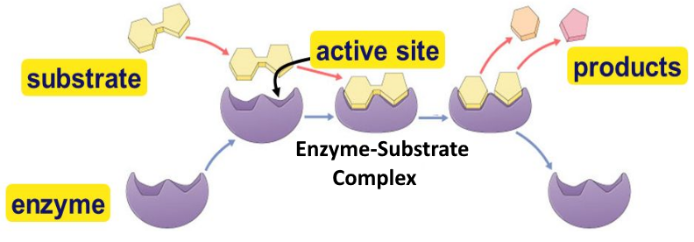
Enzymes Vocabulary
Substrate – the substance that the enzyme acts upon.
Active site – the region of an enzyme where substrate
molecules bind and undergo a chemical reaction.

Slide 6
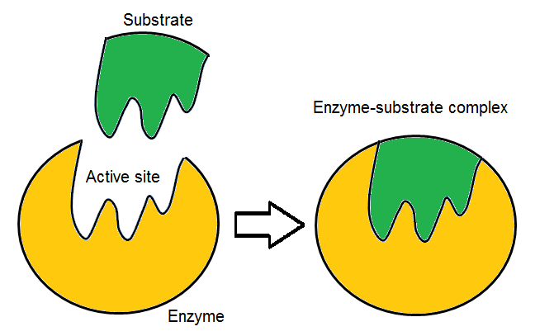
Enzyme-substrate complex:
It is the intermediate that
is formed when a substrate
binds to an enzyme at its
active site.
Products: The end result of the reaction.

Slide 7
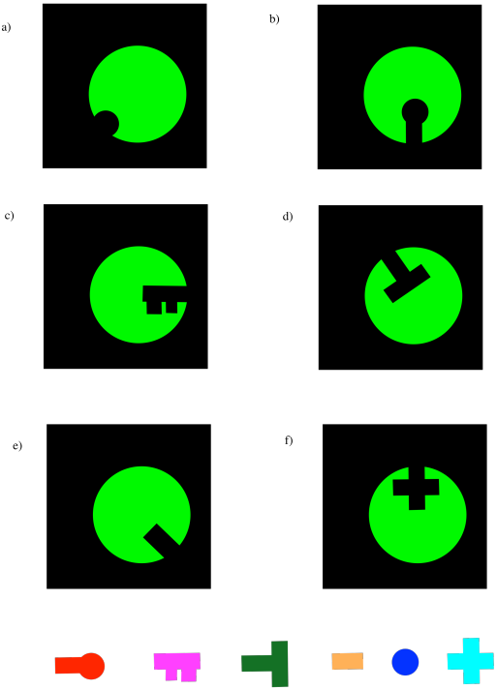
What is meant by ”substrate-specific”?
Enzymes are substrate-specific, meaning that they catalyze specific reactions ( it only fits with one substrate) :
Proteases: break peptide bonds in proteins.
Amylases: catalyze the hydrolysis of starch
Catalase: breaks down H2O2
Hint: If a substance’s name ends in the suffix “-ase”, then it is an enzyme

Slide 8
Variables affect the enzymes’ activities (or the rate of the enzymatic reaction)*
Enzyme concentration
Substrate concentration
Temperature
pH
Cofactors
Salt concentration
Pressure
Surface area
* the amount of substrate changed (or amount of product formed) in a given period of
time

Slide 9
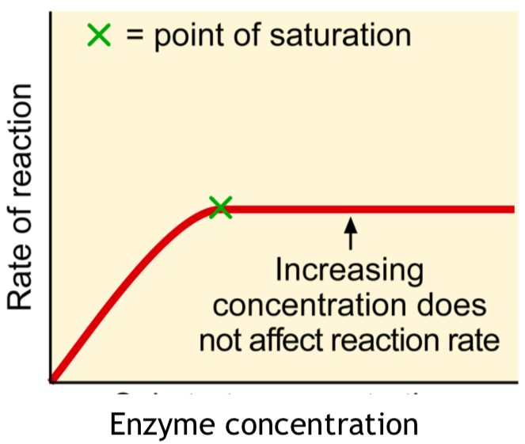
Enzyme concentration
[enzyme] rate of reaction (to a certain extent)
More enzymes = more frequently collide with substrate
At the point of saturation, all substrates are bound.
This means that:
Adding more enzymes will not increase the rate of reaction.
The substrate becomes the limiting factor.
Not all enzyme molecules
can find substrate

Slide 10
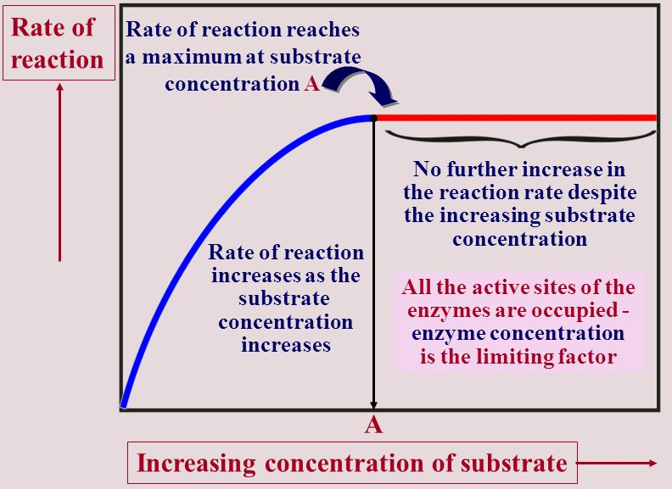
Substrate concentration
[substrate] = rate of the reaction (to a certain extent)
More substrate = more frequently collide with enzyme
At the point of saturation, all substrate are bound to enzymes.
This means that:
Adding more substrate will not increase the rate of reaction.
The enzyme becomes the limiting factor.
Not all substrate molecules
can find enzyme to bind.

Slide 11
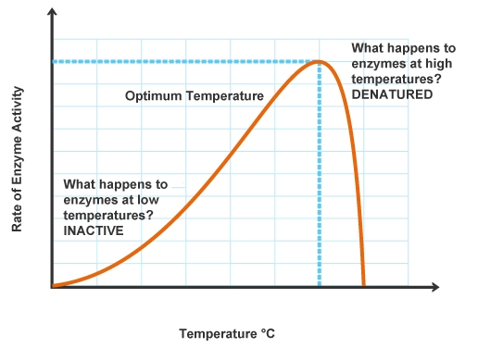
Temperature

Slide 12
Effects of temperature on enzyme activity
Optimum T^{O}:
Molecules accept their highest kinetic energy.
Then the greatest number of molecular collisions take
place.
Shows the highest enzyme’s activity.
For Human enzymes the range of optimum temperature
is 35º – 40ºC
Heat: Increase beyond optimum T^{O}:
The extreme high temperature:
Disrupts the weak bonds ( H and Ionic bond ):
in enzyme
between enzyme and substrate
Denature the enzymes = Lose the 3D shape
(3º structure)

Slide 13
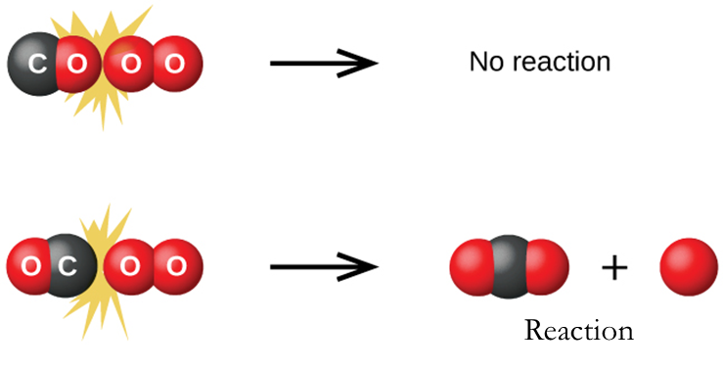
Cold temperature: Decrease away from optimum T^{O}:
Lower the kinetic energy of molecules
Molecules move slower
Decrease the collision between enzyme and substrate
At extreme low T^{O} the enzyme will be inactivated and this will
inhibit the reaction

Slide 14
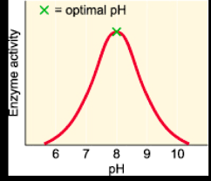
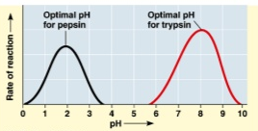
Effect of pH on enzyme’s activity
Optimum pH:
It is the pH at which the enzyme is
most effective
For most enzymes, it lies in the range from pH 5 to pH 9
It depends on the type of the enzyme
and on where it is normally acts
( Localized condition )
e.g. Pepsin (stomach) pH 2-3
Trypsin (Intestine) pH 8

Slide 15
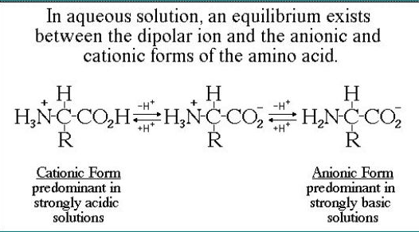
A change in pH can:
Change the charges of Carboxyl group and Amino group of
the amino acids as in the following:

Slide 16
Alter the ionization of the R groups of amino acid.
Affect the hydrogen bond and covalent bond between
amino acid of the active site and the substrate.
These changes can affect hydrogen bonding and attraction within the protein and between the protein and other molecules.
Extremely high or low pH affect the 2º and 3º structure of the enzyme, and results in a complete loss activity for most enzymes (Denaturation of enzyme).

Slide 17
Practical
We will determine the optimal conditions for the Catalase enzyme.
How? By carrying out 4 separate experiments involving enzyme concentration, substrate concentration, temperature, and pH

Slide 18
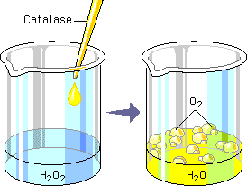
What is catalase?
Produced in the liver to rapidly catalyze the decomposition of hydrogen peroxide (H₂O₂) into oxygen (O₂) and water (H₂O)
2H₂O₂ H₂O + O₂
In today’s lab, potatoes will be the source of catalase
Liberation of O2
produces foam

Slide 19
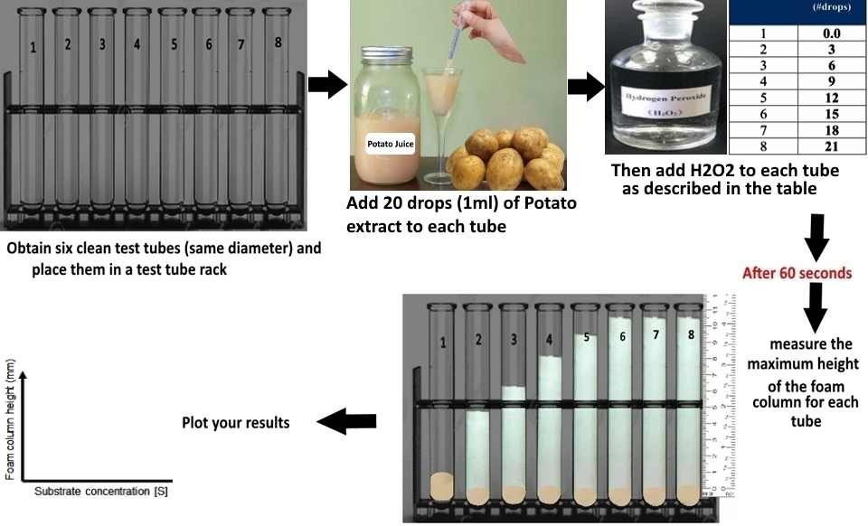
(1) Catalase activity as a function of substrate concentration

Slide 20
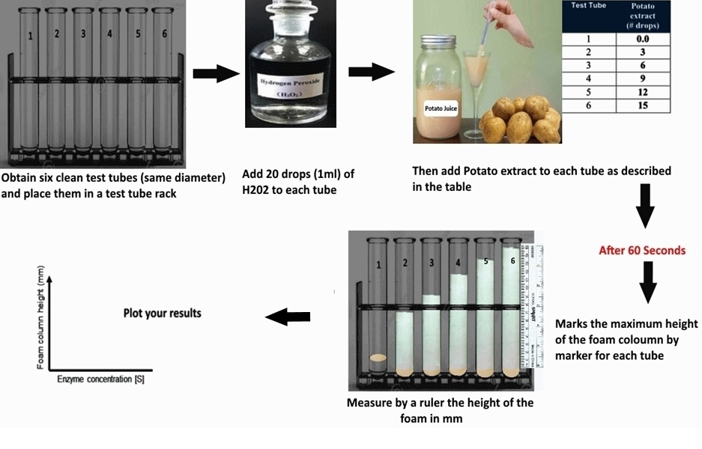
(2) Catalase activity as a function of enzyme concentration

Slide 21
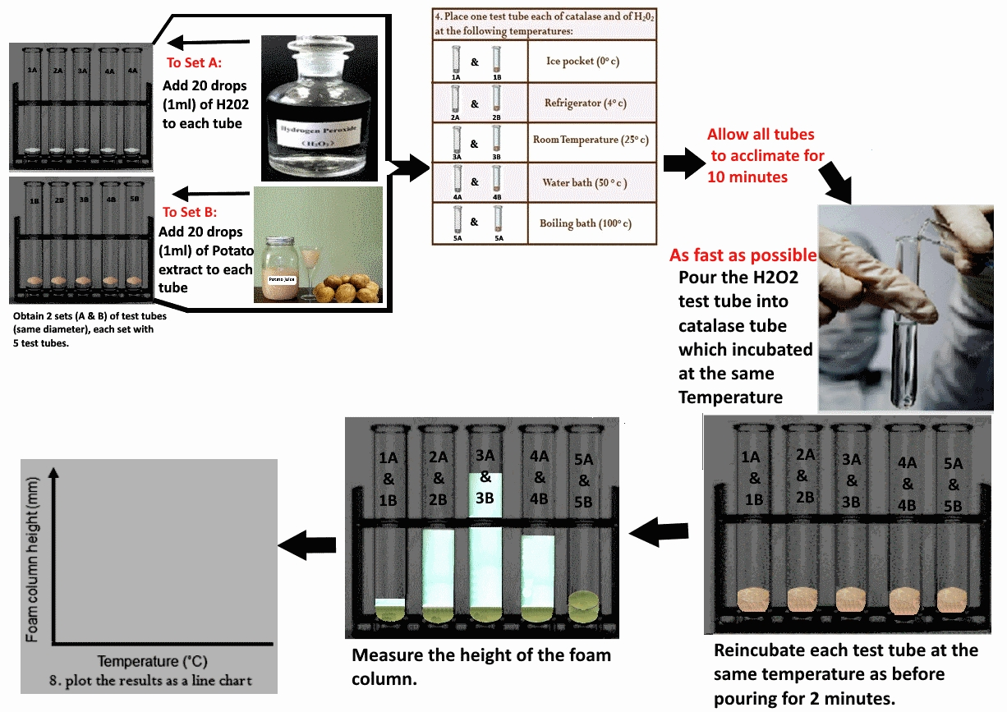
(3) Catalase activity as a function of temperature

Slide 22
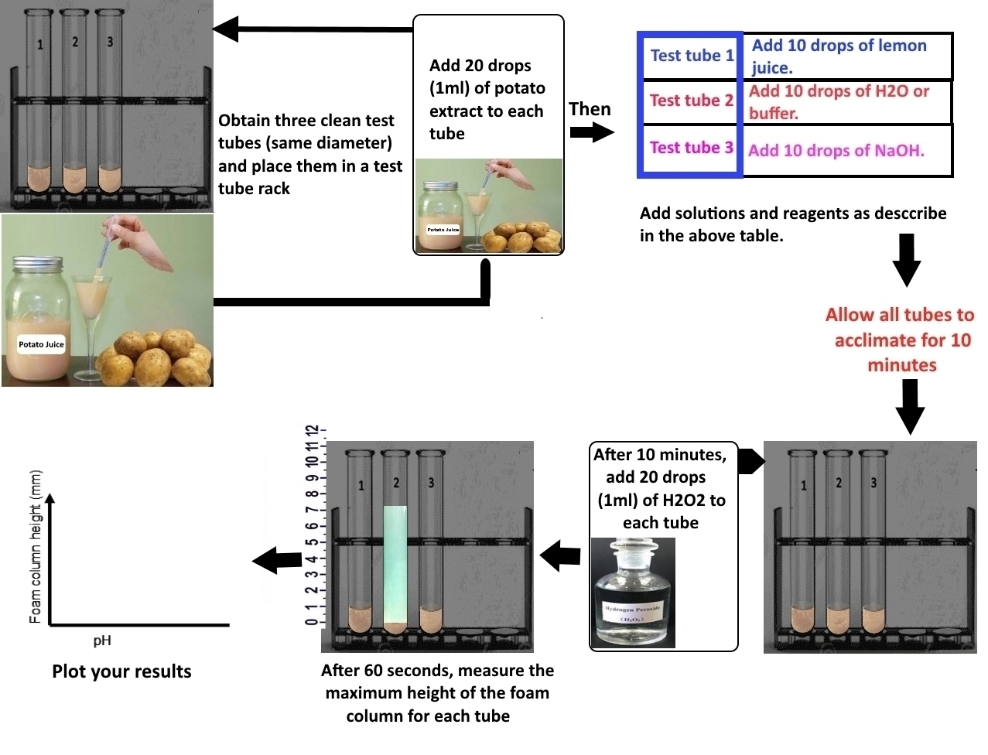
(4) Catalase activity as a function of pH

Slide 23
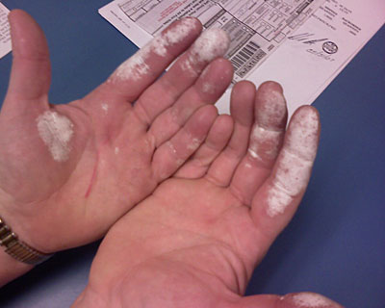
Things to note
Hydrogen peroxide is a toxic chemical which can burn skin
Immediately rinse any spills with water
Wash hands before leaving the lab

